Slide 1
Chapter 24

Slide 2
Objectives

Slide 3
Objectives (cont.)

Slide 4
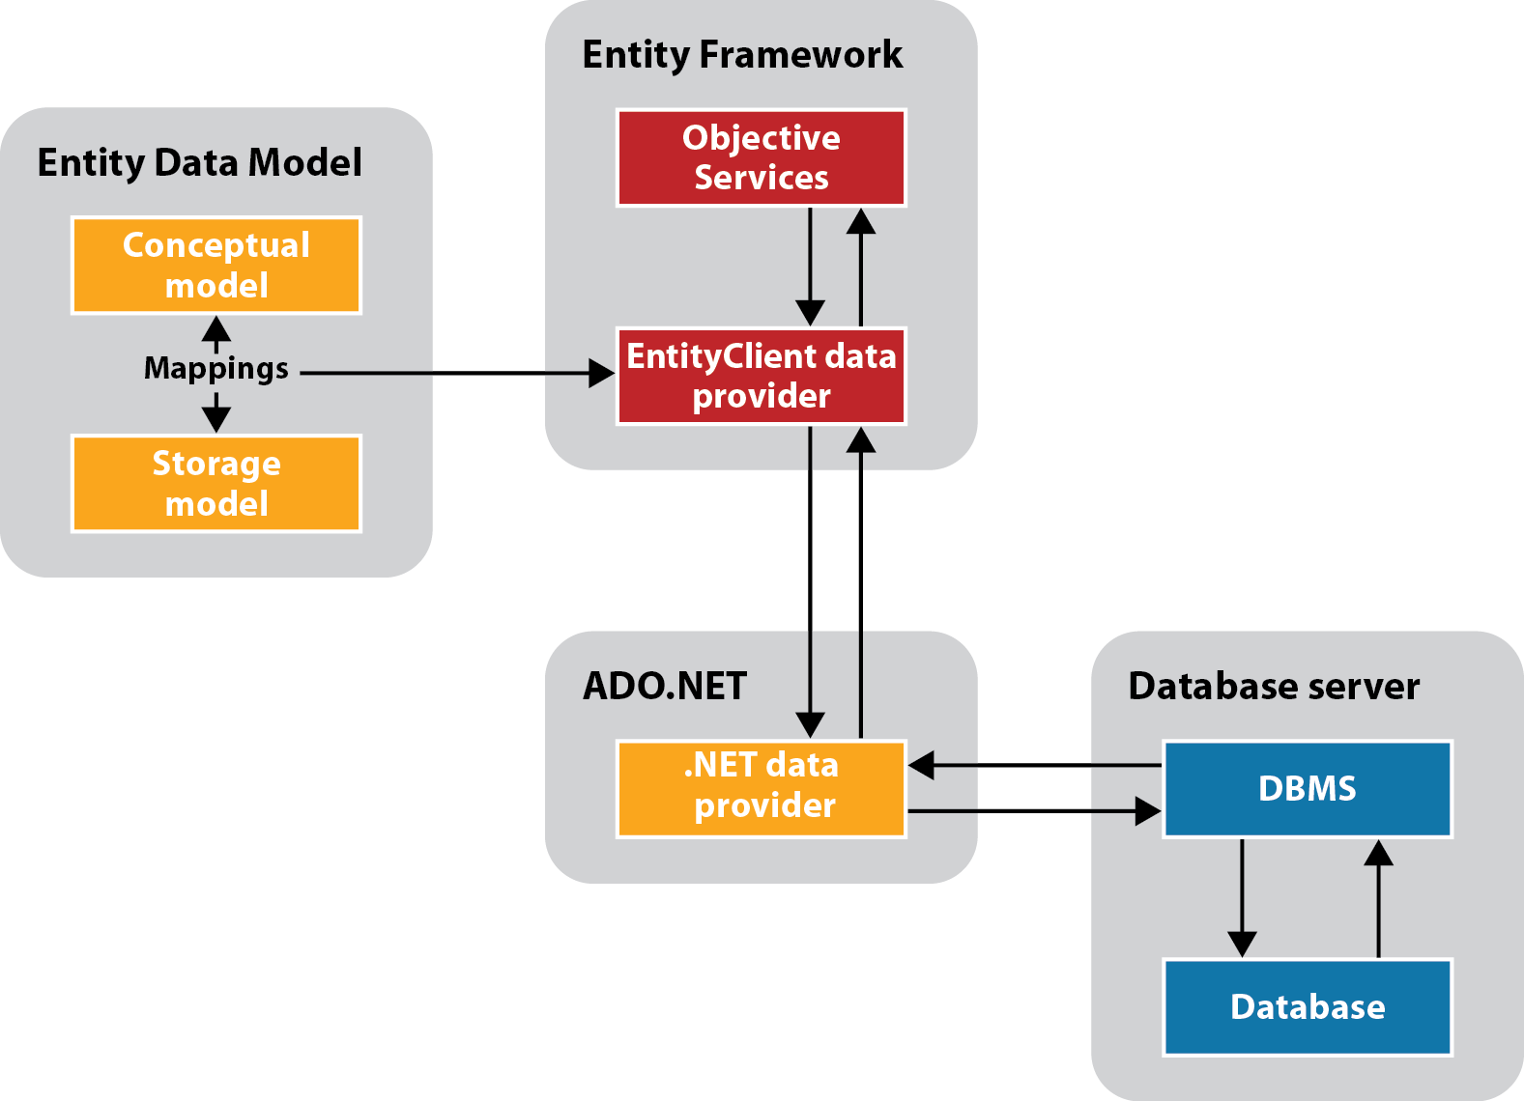
How the Entity Framework works

Slide 5
Entity Framework concepts

Slide 6
Three ways to query a conceptual model

Slide 7
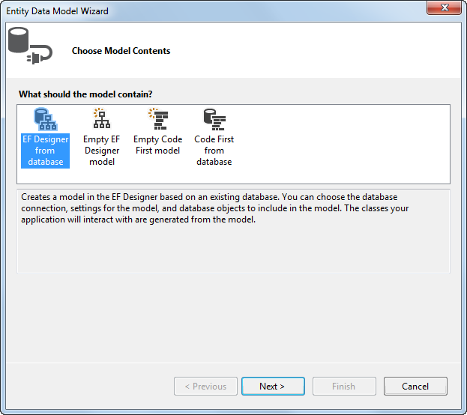
The Entity Data Model Wizard: Step 1

Slide 8
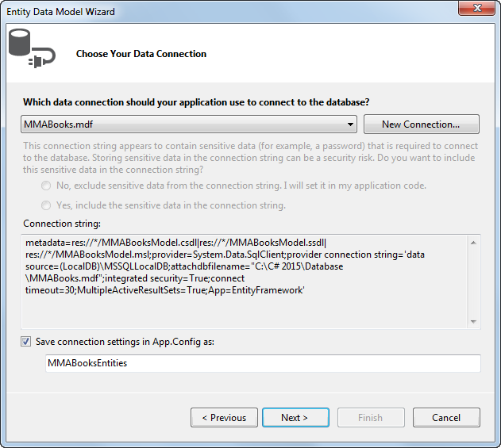
The Entity Data Model Wizard: Step 2

Slide 9
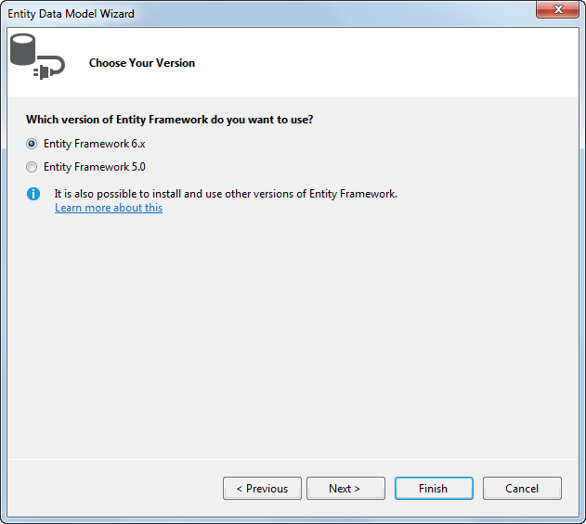
The Entity Data Model Wizard: Step 3

Slide 10
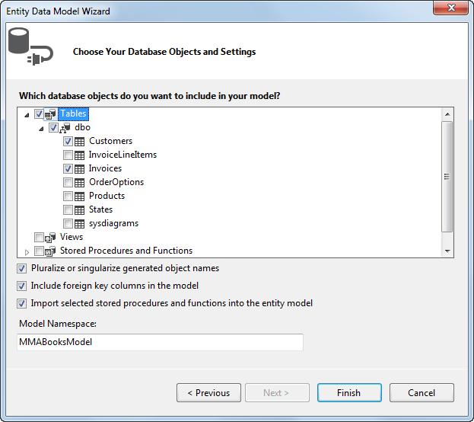
The Entity Data Model Wizard: Step 4

Slide 11
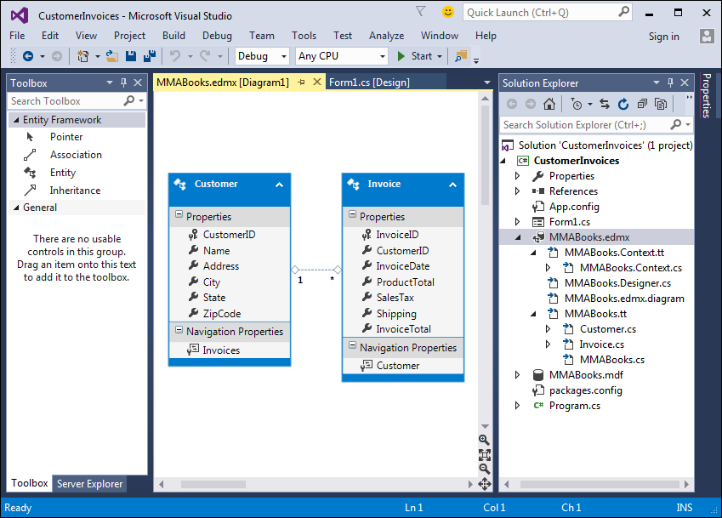
The Entity Data Model in the Entity Data Model Designer

Slide 12
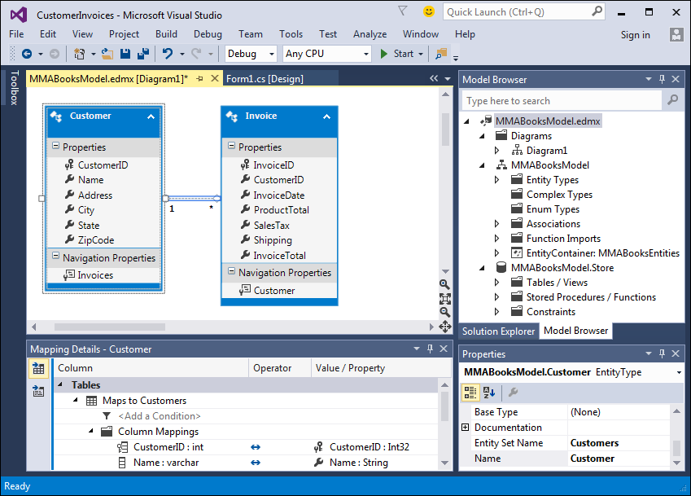
The Entity Data Model Designer

Slide 13
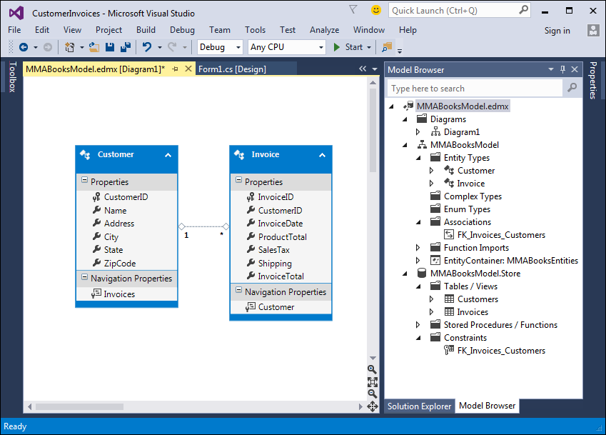
The Model Browser window with some of its nodes expanded

Slide 14
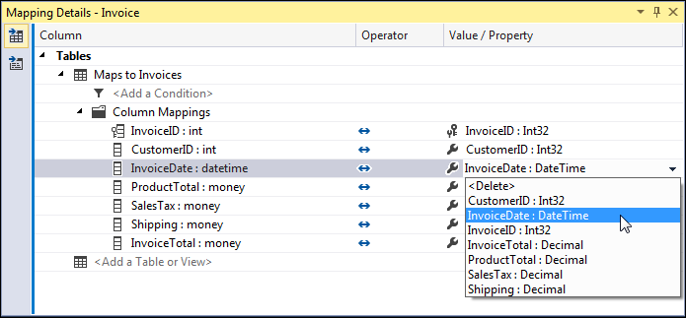
A Mapping Details window that displays the mappings for the Invoice entity

Slide 15
A LINQ query that gets data from the Invoices table

Slide 16
A LINQ query that gets data from the Invoices table (cont.)

Slide 17
A LINQ query that gets invoice data through the Customer object

Slide 18
A query expression that uses a navigation property to load related objects

Slide 19
Code that explicitly loads the objects on the many side of a relationship

Slide 20
Code that retrieves a customer row

Slide 21
Code that assigns an invoice to a different customer

Slide 22
Code that retrieves an invoice row and its related line item rows

Slide 23
Code that creates a new Invoice object

Slide 24
Code that creates a new InvoiceLineItem object

Slide 25
A try-catch statement that uses store wins for concurrency exceptions

Slide 26
Code in a catch block that uses client wins for concurrency exceptions

Slide 27
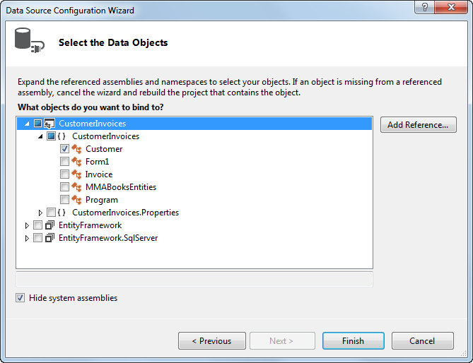
The Data Source Configuration Wizard: Step 2

Slide 28
Code that binds a combo box to an entity collection

Slide 29
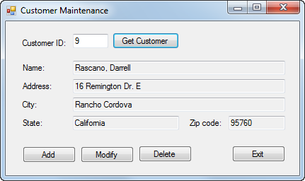
The Customer Maintenance Form

Slide 30
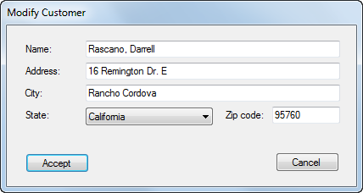
The Add/Modify Customer form

Slide 31
The default Entity Data Model

Slide 32
The code for the MMABooksEntity class

Slide 33
The Customer Maintenance form

Slide 34
The Customer Maintenance form (cont.)

Slide 35
The Customer Maintenance form (cont.)

Slide 36
The Customer Maintenance form (cont.)

Slide 37
The Customer Maintenance form (cont.)

Slide 38
The Customer Maintenance form (cont.)

Slide 39
The Add/Modify Customer form

Slide 40
The Add/Modify Customer form (cont.)

Slide 41
The Add/Modify Customer form (cont.)

Slide 42
The Add/Modify Customer form (cont.)

Slide 43
The Add/Modify Customer form (cont.)

Slide 44
Extra 24-1 Use the Entity Framework to create an Order Options Maintenance application

Slide 45
Project 5-3 Maintain incidents

